Slide 1
SRM Institute of Science and Technology Advanced Programming Practice-18CSC207J Unit 1

Slide 2
Overview of the Unit
Structured Programming Paradigm
Procedural Programming Paradigm
Object Oriented Programming Paradigm

Slide 3
3. Object-Oriented Programming
Session 11-15 covers the following Topics:-
Object Oriented Programming Paradigm
Class, Objects, Instances, Methods
Encapsulation, Data Abstraction
Polymorphism, Inheritance
Constructor, Destructor
Example Languages: BETA, Cecil, Lava.
Demo: OOP in Python
Lab 3: Object Oriented Programming
Text Book: Shalom, Elad. A Review of Programming Paradigms Throughout the History: With a Suggestion Toward a Future Approach

Slide 4
Object-Oriented Programming
Based on the concept of objects - attributes and methods. Objects are instances of classes which interact with one another.
OOP treat data as a critical element in the program development and does not allow it to flow freely around the system.
It ties data more closely to the functions that operate on it, and protects it from accidental modification from outside functions.
OOP allows decomposition of a problem into a number of entities called objects and then build data functions around these objects.

Slide 5
Overview
Object-oriented programming attempts to provide a model for programming based on objects.
Objects are designed in class hierarchies.
Merges abstract data types with structured programming and divides systems into modular objects which own their own data and are responsible for their own behavior. This feature is known as encapsulation.
The construct that combines data with a set of methods for accessing and managing data is called an object.
Two goals in the object-oriented paradigm also known as the open/closed principle

Slide 6
Concepts - Objects and reference variables
STATEMENT | VISUAL PICTURIZATION
int x | X
X= 45 | X
String str; str = “Java” | Str 1050
str = new String(“Java”);
Not a primitive data type
45
String Object
1050
Java
Operator
String Object
Instances of Class String
Reference Variable

Slide 7
Hence..
While working with classes
Reference variable of a class type is declared
An object is instantiated and its address is stored into the reference variable.
Two types of variables can be declared in Java: primitive type variables and reference variables.
Primitive type variables store data directly into their own memory spaces while Reference variables store the address of the object containing the data.
In some languages, such as C++, reference variables - pointers.

Slide 8
Methods – overview and predefined methods
A method in object-oriented programming is a procedure associated with an object class.
A simple example would be a window object that has methods open and close.
Overriding is a feature that allows a subclass or child class to provide a specific implementation of a method that is already provided by one of its superclasses or parent classes. Version of method is based on Object.
Methods also provide the interface that other classes use to access and modify the data properties of an object. This is known as encapsulation.
A class is a collection of methods and data members.

Slide 9
Advantages -Method
While working on one method, you can focus on just that part of the program and construct it, debug it, and perfect it.
Different people can work on different methods simultaneously.
If a method is needed in more than one place in a program, or in different programs, it can be written once and used many times. - reuse
Using methods greatly enhances the program’s readability because it reduces the complexity of the method main.
Methods are also known as Modules

Slide 10
Every method has a name and, depending on the values specified by the user, it does some computation.
Predefined methods in Java are organized as a collection of classes, called class libraries.
For example, the class Math contains mathematical methods and it is contained in the package java.lang.
By default, Java automatically imports classes from the package java.lang.
Return type double
pow(x,y)
Parameter or argument
//to use any static method of the class
import static packageName.ClassName.*;
//to use a specific static method of the class
import static packageName.ClassName.methodName;
import java.util.*;
Wildcard
Math.methodName(parameters);

Slide 11
Methods – Final Note
To use methods, it is important to know the following properties
the name of the method
the number of parameters, if any
the data type of each parameter
The data type of the value computed (the value returned) by the method, called the type of the method

Slide 12
Methods – user-defined methods and method overloading
User-defined methods in Java are classified into two categories:
value-returning methods – methods that have a return data type; these methods return a value of a specific data type using the return statement.
Example: pow , sqrt , isLowerCase, toUpperCase
void methods – methods that do not have a return data type; these methods do not use a return statement to return a value.

Slide 13
Formal Vs Actual Parameter
public static int abs(int number)
{
if(number < 0)
number = -number;
return number;
}
int n = abs(-15);
Formal parameter: A variable declared in the method heading.
Actual parameter: A variable or expression listed in a call to a method.
Formal parameter
Actual parameter

Slide 14
Method - Components
public static double larger(double x, double y)
{
double max;
if(x >= y)
{
max = x;
}
else
max = y;
return max;
}

Slide 15
Method - Components
public static double larger(double x, double y)
{
double max;
if(x >= y)
{
max = x;
}
else
max = y;
return max;
}
Modifier
Method type
Formal parameter
Method name
Local declaration
Modifier
Public
private
protected
static
abstract
final
Expression

Slide 16
Method overload
In Java, several methods can have the same name within a class. This is called method overloading.
Overloading the method methodXYZ
public void methodXYZ()
public void methodXYZ(int x, double y)
public void methodXYZ(double one, int y) CORRECT
public void methodXYZ(int x, double y, char c)
public void methodABC(int x, double y) WRONG
public int methodABS(int x, double y)

Slide 17
Example
int larger(int x, int y)
char larger(char first, char second)
double larger(double u, double v)
String larger(String first, String second)
larger(5, 3)
larger(‘A’, ‘9’),

Slide 18
Classes and instances
Class is an extensible program-code template for
Creating objects,
Providing initial values for state
Implementations of behavior
When a constructor creates an object, that object is called an instance of the class.
The creation of an instance is called instantiation.
Not all classes can be instantiated, like abstract classes, while those that can be instantiated are called concrete classes.
After instantiation, the member variables specific to the object are called instance variables, to contrast with the class variables shared across the class.

Slide 19
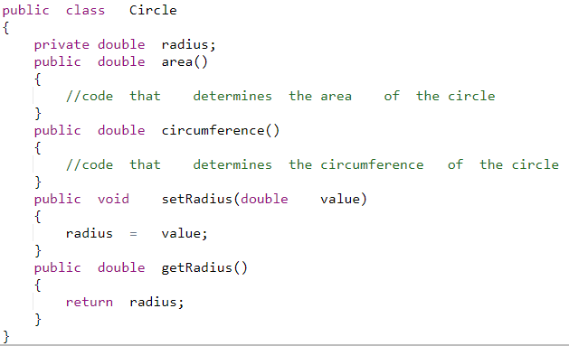
Setters or mutator
Getter or accessor

Slide 20
CONSTRUCTOR
The name of a constructor is the same as the name of the class.
A constructor, even though it is a method, has no return type. That is, it is neither a value-returning method nor a void method.
A class can have more than one constructor. - Overloaded.
If a class has more than one constructor, the constructors must have different signatures.
Constructors execute automatically when objects are instantiated.
If there are multiple constructors, the constructor that executes depends on the type values passed to the class object when the class object is instantiated.

Slide 21
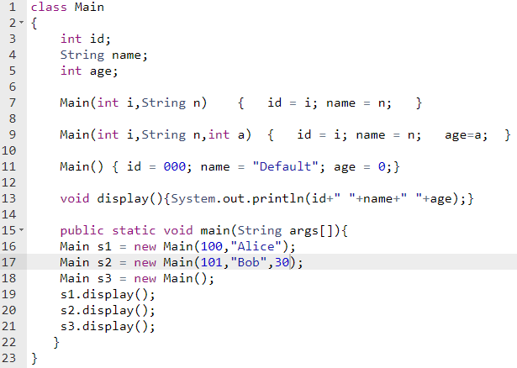


Slide 22
Basic Concepts of OOP
Objects
Object : CUSTOMER
Object : ACCOUNT
DATA
AC No.
Name of AC Holder
Address
DATA
AC No.
AC Balance
Type of Account
FUNCTIONS
Deposit
Withdrawal
AC Balance Display
FUNCTIONS
Account Balance

Slide 23
Basic Concepts of OOP
Classes
Classes are user-defined data types.
The entire set of data and code of an object can be made a user-defined data type with the help of a class. Objects are variables of the type class. Once a class has been defined, we can create any number of objects belonging to that class. Each object is associated with the data of type class with which they are created.
A class is a collection of objects of similar type.

Slide 24
Basic Concepts of OOP
Classes
If fruit has been defined as a class, then the statement
f r u i t m a n g o ;
will create an object mango belonging to the class fruit.

Slide 25
Data Abstraction and Encapsulation
The wrapping up of data and functions into a single unit is known as encapsulation.
The data is not accessible to the outside world, and only those functions which are wrapped in the class can access it.
These functions provide the interface between the object’s data and the program. This insulation of the data from direct access by the program is called data hiding or information hiding.

Slide 26
Data Abstraction and Encapsulation
The attributes wrapped in the classes are called data members and the functions that operate on these data are called methods or member functions.
Since the classes use the concept of data abstraction, they are known as Abstracted Data Types (ADT).

Slide 27
Inheritance
Inheritance is the process by which objects of one class acquire the properties of objects of another class.
It supports the concept of hierarchical classification.
Each derived class shares common characteristics with the class from which it is derived.

Slide 28
Property Inheritance
Bird
Attributes:
Feathers
Lay eggs
Flying Bird
Non-flying Bird
Attributes:
------------
------------
Attributes:
------------
------------
Robin
Swallow
Penguin
Kiwi
Attributes:
------------
------------
Attributes:
------------
------------
Attributes:
------------
------------
Attributes:
------------
------------

Slide 29
Inheritance
Inheritance provides the idea of reusability.
We can add additional features to an existing class without modifying it.
(By deriving new class from existing one. The new class will have the combined features of both the classes.)

Slide 30
Polymorphism - ability to take more than one form
An operation may exhibit different behaviours in different instances.
The behaviour depends upon the types of data used in the operation.
add( 3, 5) gives 8
Add(“hello”, “-world”) gives “hello-world”

Slide 31
Polymorphism - ability to take more than one form
The process of making an operator to exhibit different behaviours in different instances is known as operator overloading.
<< Insertion Operator
<< Left-shift bit-wise operator
Using a single function name to perform different types of tasks is known as function overloading.
add( 3, 5) gives 8
Add(“hello”, “-world”) gives “hello-world”

Slide 32
Dynamic Binding
Binding refers to the linking of a procedure call to the code to be executed in response to the call.
Dynamic binding ( late binding ) means that the code associated with a given procedure call is not known until the time of the call at run-time.
It is associated with polymorphism and inheritance.

Slide 33
Message Passing
An oop consists of a set of objects that communicate with each other.
Oop involves the following steps:
Creating classes that define objects and their behaviour.
Creating objects from class definitions.
Establishing communication among objects.
Objects communicate with one another by sending and receiving information.

Slide 34
Message Passing
A message for an object is a request for execution of a procedure.
The receiving object will invoke a function and generates results.
Message passing involves specifying:
The name of the Object.
The name of the Function.
The information to be send.

Slide 35
Benefits of OOP
Inheritance – eliminate redundant code and extend the use of existing classes.
We can build programs from the standard working module, no need of starting from the scratch.
Data hiding helps the programmer to build secure programs that can not be invaded by code in other parts of the program.

Slide 36
Multiple instances of an objects can co-exists with out any interference.
It is easy to partition the work in a project based on objects.
Object-oriented system can be easily upgraded from small to large systems.
Message passing techniques for communication between objects makes the interface descriptions with external systems much simpler.
Software complexity can be easily managed.

Slide 37
INTRODUCTION TO OOPS IN PYTHON
Python is a multi-paradigm programming language. Meaning, it supports different programming approach.
One of the popular approach to solve a programming problem is by creating objects. This is known as Object-Oriented Programming (OOP).
An object has two characteristics:
attributes
behavior
Let's take an example:
Student is an object,
name, age, gender are attributes
singing, dancing are behavior

Slide 38
OBJECT-ORIENTED PROGRAMMING
OOP treat data as a critical element in the program development and does not allow it to flow freely around the system.
It ties data more closely to the functions that operate on it, and protects it from accidental modification from outside functions.
OOP allows decomposition of a problem into a number of entities called objects and then build data functions around these objects.
The data of an object can be accessed only by the functions associated with that object.
Functions of one object can access the functions of another objects

Slide 39
ORGANIZATION OF DATA AND FUNCTIONS IN OOP
Object A
Object B
Data
Data
Communication
Functions
Functions
Object C
Data
Functions

Slide 40
CHARACTERISTICS OF OBJECT-ORIENTED PROGRAMMING
Emphasis is on data rather than procedure.
Programs are divided into objects.
Data structures are designed such that they characterize the objects.
Functions that operate on the data of an object are tied together in the data structure.
Data is hidden and can not be accessed by external functions.
Objects may communicate with each other through functions.
New data and functions can be added easily whenever necessary.
Follows bottom-up approach in program design.

Slide 41
The concept of OOP in Python focuses on creating reusable code. In Python, the concept of OOP follows some basic principles:
Inheritance A process of using details from a new class without modifying existing class.
Encapsulation Hiding the private details of a class from other objects.
Polymorphism A concept of using common operation in different ways for different data input.

Slide 42
CLASS
A class is a blueprint for the object or user defined data type.
It contains all the details about the name, gender, size etc. Based on these descriptions ,Here, Student is an object.
The example for class of Student can be :
class Student:
Here, we use class keyword to define an empty class Student. From class, we construct instances. An instance is a specific object created from a particular class.
OBJECT
An object (instance) is an instantiation of a class. When class is defined, only the description for the object is defined. Therefore, no memory or storage is allocated.
The example for object of Student class can be:
obj = Student()
Here, obj is object of class Student.
Suppose we have details of Student. Now, we are going to show how to build the class and objects of Student.

Slide 43

EXAMPLE FOR CLASS & OBJECT
OUTPUT

Slide 44
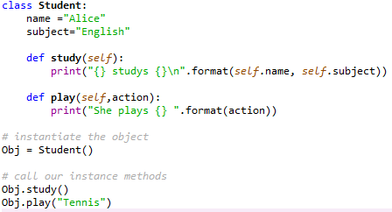

METHODS
Methods are functions defined inside the body of a class. They are used to define the behaviors of an object.

Slide 45
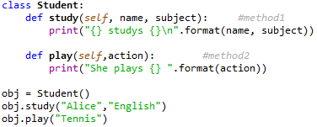
METHODS
Methods are functions defined inside the body of a class. They are used to define the behaviors of an object.

Slide 46
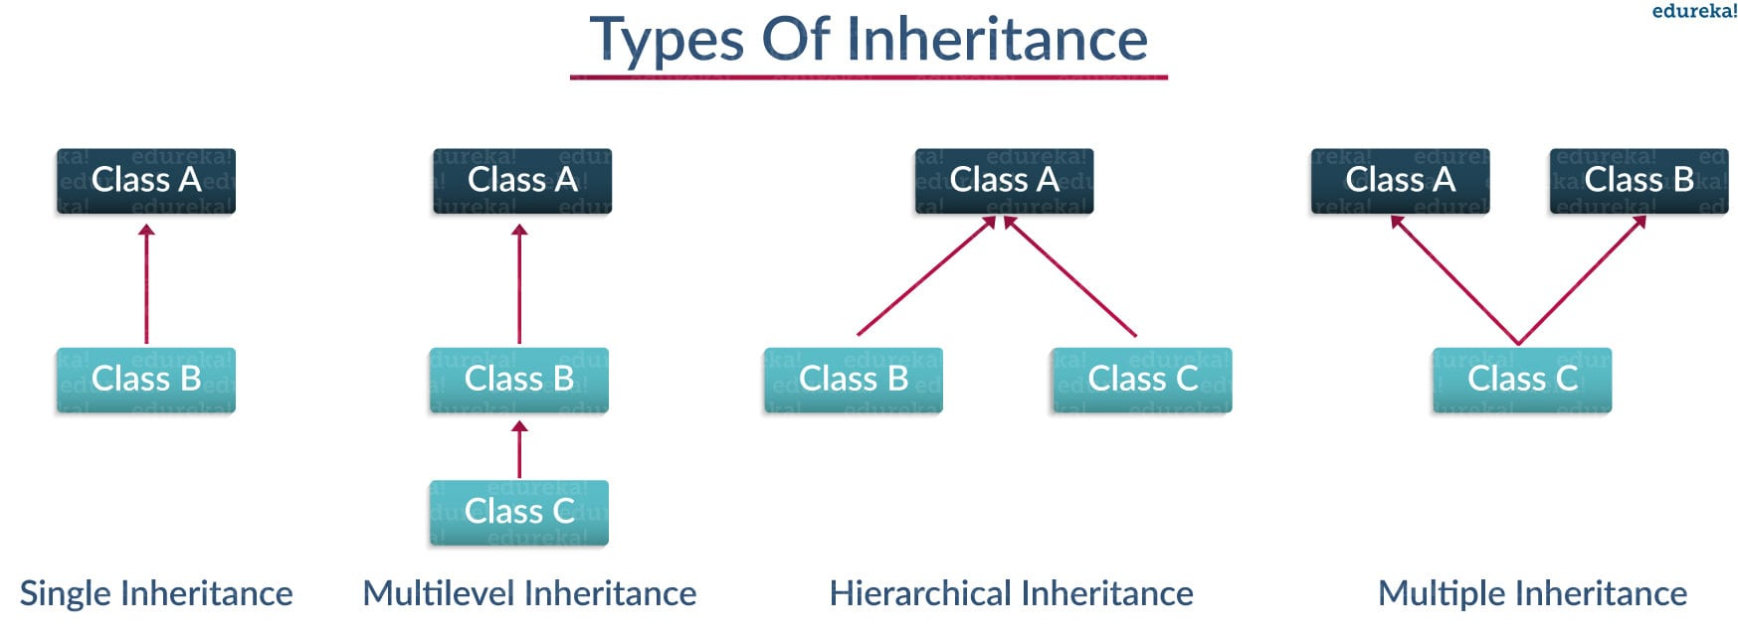
INHERITANCE
Inheritance is a way of creating new class for using details of existing class without modifying it. The newly formed class is a derived class (or child class). Similarly, the existing class is a base class (or parent class).

Slide 47
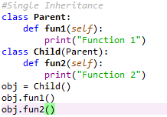

SINGLE INHERITANCE
Child class inherits only a single parent class

Slide 48
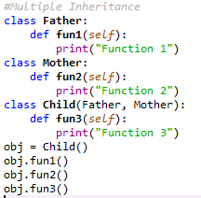

MULTIPLE INHERITANCE
Child class inherits from more than one parent class

Slide 49
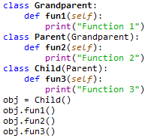
MULTILEVEL INHERITANCE
Child class inherits from another child class

Slide 50
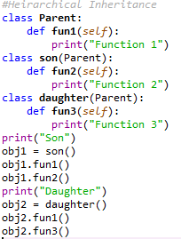

HIERARCHICAL INHERITANCE
Many children from same parent class

Slide 51
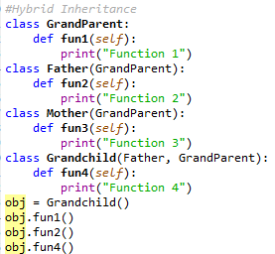

HYBRID INHERITANCE
Combination of above mentioned types

Slide 52
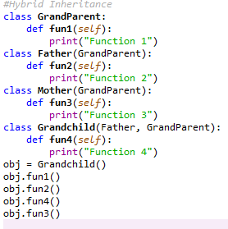
HYBRID – WRONG EXAMPLE

Slide 53
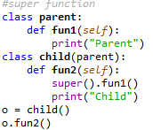
Super () IN PYTHON
A child class calls the method of immediate parent

Slide 54
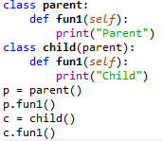
OVERRIDING
Functionality of a parent class is updated by child class

Slide 55
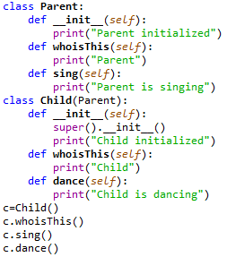

INHERITANCE – OVERRIDE , SUPER , CONSTRUCTOR
PRIVATE
UPDATE
EXTEND
INHERIT

Slide 56
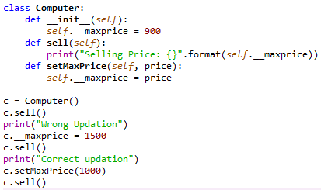

DATA ENCAPSULATION IN PYTHON

Slide 57
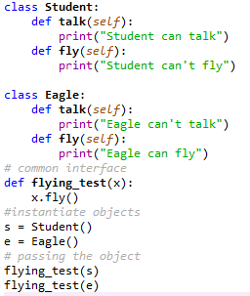

POLYMORPHISM

Slide 58
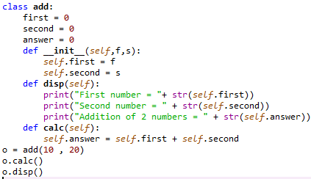

PARAMETRIZED CONSTRUCTOR

Slide 59
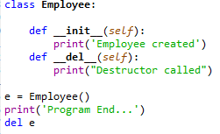

DESTRUCTORS IN PYTHON
Destructors are called when an object gets destroyed. In Python, destructors are not needed as much needed in C++ because Python has a garbage collector that handles memory management automatically. The __del__() method is a known as a destructor method in Python.

Slide 60
Python - public, private and protected Access Modifiers
All members in a Python class are public by default. Any member can be accessed from outside the class environment.
Example: Public Attributes
class employee:
def __init__(self, name, sal):
self.name=name
self.salary=sal

Slide 61
Python's convention to make an instance variable protected is to add a prefix _ (single underscore) to it. This effectively prevents it to be accessed, unless it is from within a sub-class.
Example: Protected Attributes
class employee:
def __init__(self, name, sal):
self._name=name # protected attribute
self._salary=sal # protected attribute

Slide 62
Similarly, a double underscore __ prefixed to a variable makes it private. It gives a strong suggestion not to touch it from outside the class. Any attempt to do so will result in an AttributeError:
Example: Private Attributes
class employee:
def __init__(self, name, sal):
self.__name=name # private attribute
self.__salary=sal # private attribute

Slide 63
RECAP
Public – no underscore E.g.: self.name
Protected – single underscore E.g.: self._name
Private – double underscore E.g.: self.__name

Slide 64
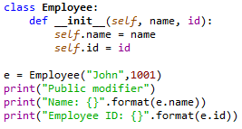

PUBLIC MODIFIER

Slide 65
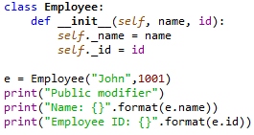
PROTECTED MODIFIER

Slide 66
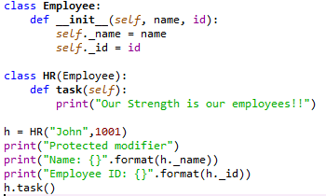

PROTECTED MODIFIER

Slide 67
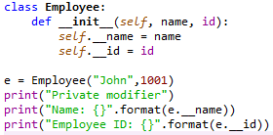
PRIVATE MODIFIER

